Slide 1

Hidden Markov Model
Application of Unsupervised Machine Learning to Algorithmic Trading
Joel Thomas, Victoria Zhang and Liam Horrocks
FNCE30010: Algorithmic Trading

Slide 2
Introduction to Hidden Markov Model

Slide 3
Intro to HMM
Unsupervised Machine Learning algorithm
Area of ML that learns from unlabelled, unclassified or uncategorised test data
Probabilistically model an observation sequence of random processes
Extension to Markov Chains
Presence of hidden or latent variables
Cannot be observed in real life

Slide 4
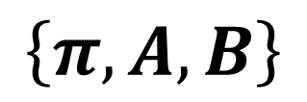

Discrete Hidden Markov Model
Hidden
$$\left\{π,A,B\right\}$$
State 1
State 2
State 3
State 4
$$λ$$
Observed
Parameters
?
Symbol 1
Symbol 2
Symbol 3
Symbol 4
Symbol 5
Next Symbol
Historical Stock Closing Price
Next Period Closing Price
Introduction | Basic Strategy | Improvised Strategy | Discussion | Conclusion

Slide 5
HMMs with Gaussian Mixture Model
Hidden
State 1
State 2
State 3
State 4
Symbol 1
Symbol 2
Symbol 3
Symbol 4
Symbol 5
Introduction | Basic Strategy | Improvised Strategy | Discussion | Conclusion

Slide 6
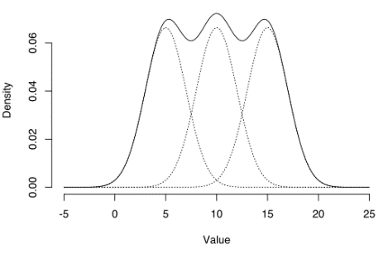
HMMs with Gaussian Mixture Model
Hidden
State 1
State 2
State 3
State 4
Introduction | Basic Strategy | Improvised Strategy | Discussion | Conclusion

Slide 7

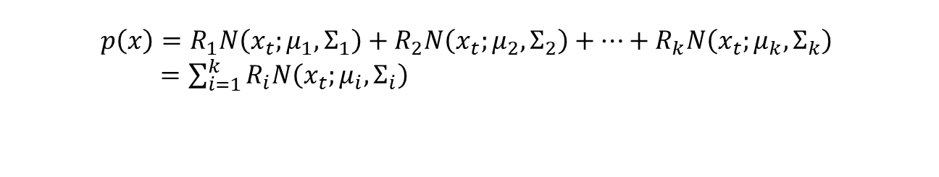
HMMs with Gaussian Mixture Model
Gaussian Mixture Model
$$p\left(x\right)=R_{1}N\left(x_{t};μ_{1},Σ_{1}\right)+R_{2}N\left(x_{t};μ_{2},Σ_{2}\right)+…+R_{k}N\left(x_{t};μ_{k},Σ_{k}\right)$$
$=\sum_{i=1}^{k}{R_{i}N\left(x_{t};μ_{i},Σ_{i}\right)}$
Introduction | Basic Strategy | Improvised Strategy | Discussion | Conclusion

Slide 8
Original Strategy

Slide 9
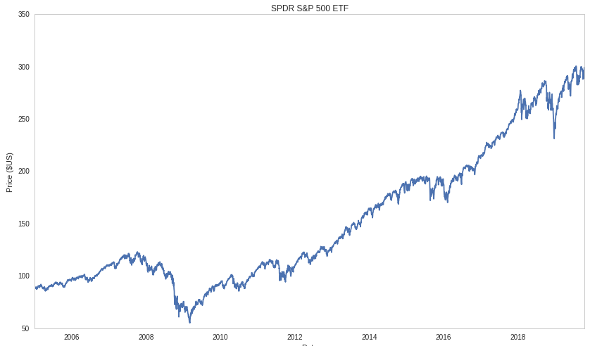
HMM on SPY
6-Week Training Data
Introduction | Basic Strategy | Improvised Strategy | Discussion | Conclusion

Slide 10
HMM on SPY
6-Week Training Data
Introduction | Basic Strategy | Improvised Strategy | Discussion | Conclusion

Slide 11
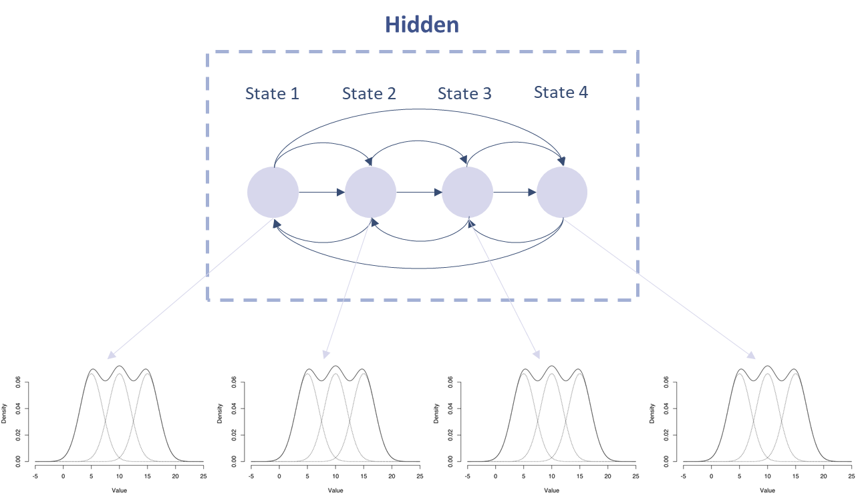

HMM on SPY
$$λ$$
Parameters
6-Week Training Data
Introduction | Basic Strategy | Improvised Strategy | Discussion | Conclusion

Slide 12



HMM on SPY
$$λ$$
$$P(X^{∗}|λ)≈P(X|λ)$$
$$P(X|λ)$$
$${\tilde{x}}_{t+1}$$
Introduction | Basic Strategy | Improvised Strategy | Discussion | Conclusion

Slide 13
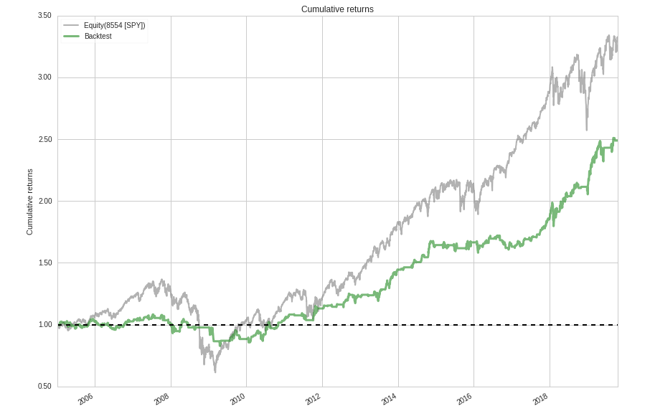
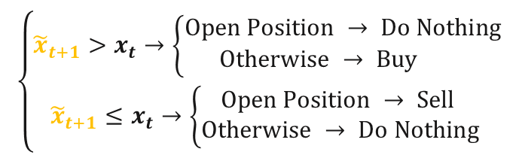
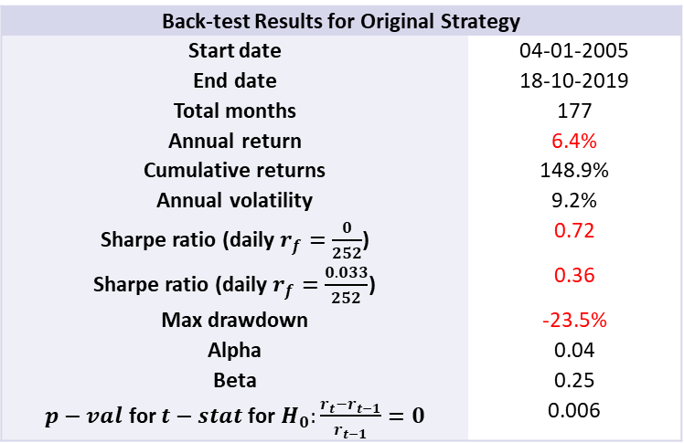
HMM on SPY
Back-test Results for Original Strategy
Start date | 04-01-2005
End date | 18-10-2019
Total months | 177
Annual return | 6.4%
Cumulative returns | 148.9%
Annual volatility | 9.2%
Sharpe ratio (daily $r_{f}=\frac{0}{252}$) | 0.72
Sharpe ratio (daily $r_{f}=\frac{0.033}{252}$) | 0.36
Max drawdown | -23.5%
Alpha | 0.04
Beta | 0.25
$p−val$ for $t−stat$ for $H_{0}:\frac{r_{t}−r_{t−1}}{r_{t−1}}=0$ | 0.006
$$\left\{\begin{aligned}{\tilde{x}}_{t+1}>x_{t}→\left\{\begin{aligned}Open Position → Do Nothing \\ Otherwise → Buy \end{aligned}\right. \\ {\tilde{x}}_{t+1}≤x_{t}→\left\{\begin{aligned}Open Position → Sell \\ Otherwise → Do Nothing\end{aligned}\right. \end{aligned}\right.$$
Introduction | Basic Strategy | Improvised Strategy | Discussion | Conclusion

Slide 14
Improvised Strategy

Slide 15
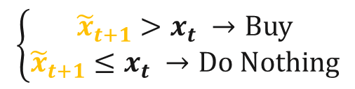
Momentum + HMMs
If in the short term, the future repeats the past…
Momentum Indicator
Portfolio
Entire universe of US stocks
Top 50 volume stocks
3 Stock with the highest last month return
$$\left\{\begin{aligned}{\tilde{x}}_{t+1}>x_{t} →Buy \\ {\tilde{x}}_{t+1}≤x_{t} →Do Nothing\end{aligned}\right.$$
Introduction | Basic Strategy | Improvised Strategy | Discussion | Conclusion
Notes:
(Jegadeesh et al., 2001)…

Slide 16
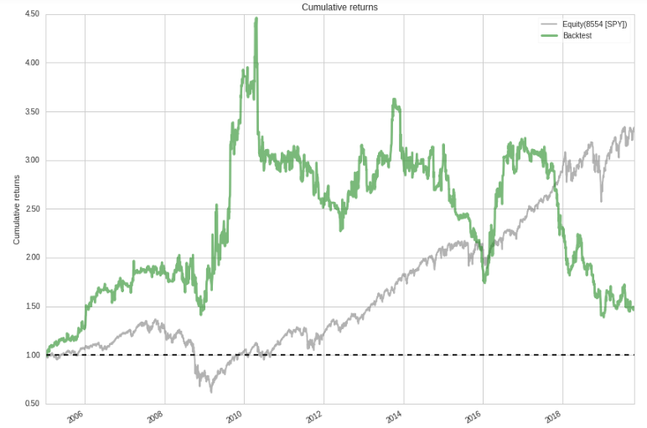
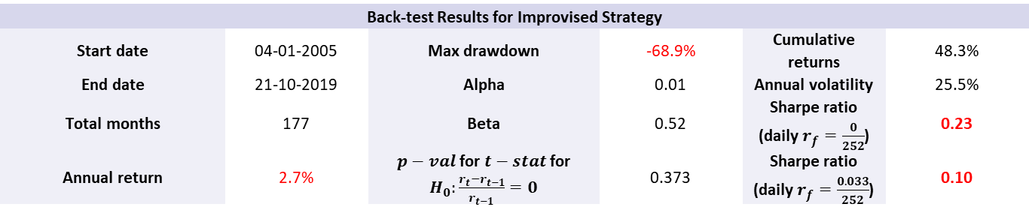
Momentum + HMMs
Back-test Results for Improvised Strategy
Start date | 04-01-2005 | Max drawdown | -68.9% | Cumulative returns | 48.3%
End date | 21-10-2019 | Alpha | 0.01 | Annual volatility | 25.5%
Total months | 177 | Beta | 0.52 | Sharpe ratio (daily $r_{f}=\frac{0}{252}$) | 0.23
Annual return | 2.7% | $p−val$ for $t−stat$ for $H_{0}:\frac{r_{t}−r_{t−1}}{r_{t−1}}=0$ | 0.373 | Sharpe ratio (daily $r_{f}=\frac{0.033}{252}$) | 0.10
Introduction | Basic Strategy | Improvised Strategy | Discussion | Conclusion

Slide 17
Discussion

Slide 18
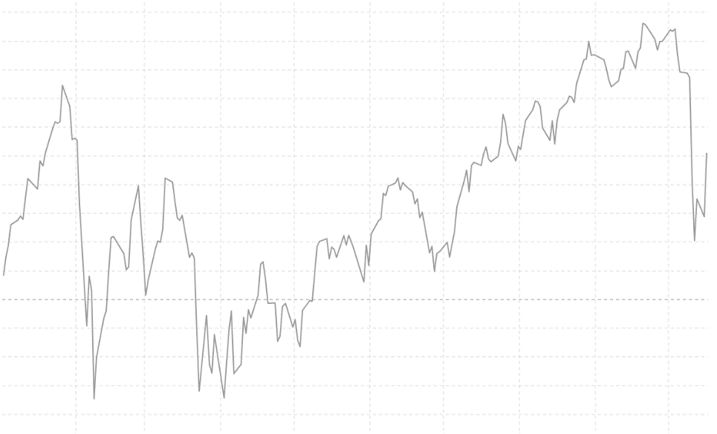
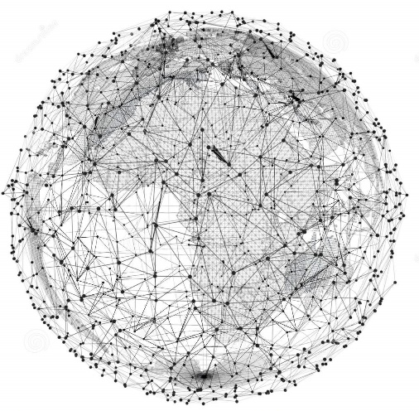
Weaknesses
Information Capturing:
1. Limited Number of Hidden States
2. Short Training Window
1
2
Intuitively we are trying to find similar patterns using minimal data points, which might not be an ideal choice if we are trying to find the history that is highly similar to the current situation.
Introduction | Basic Strategy | Improvised Strategy | Discussion | Conclusion

Slide 19
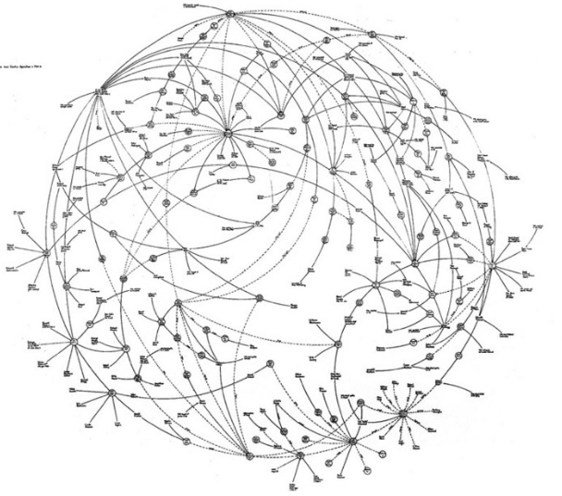
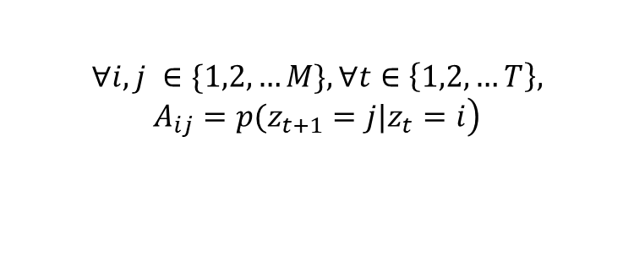
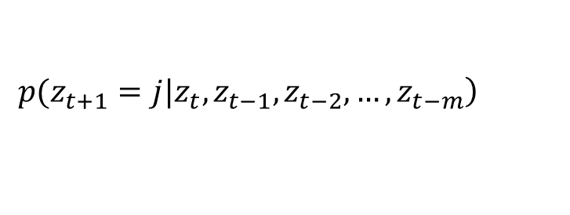
Weaknesses
Model Assumption – Markov Property:
Methodology:
Historical Stock Price
?
$$\left.∀i, j ∈\{1,2,…M\}, ∀t∈\left\{1,2,…T\right\}, A_{ij}=p(z_{t+1}=j|z_{t}=i\right)$$
$$\left.p(z_{t+1}=j|z_{t}, z_{t−1}, z_{t−2},…,z_{t−m}\right)$$
?
Predict the Future
Introduction | Basic Strategy | Improvised Strategy | Discussion | Conclusion

Slide 20
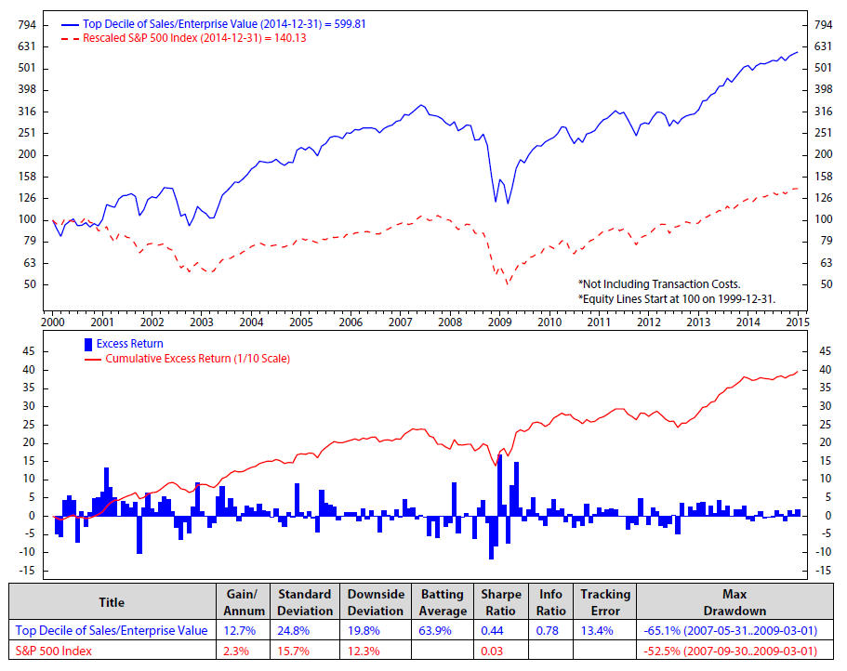
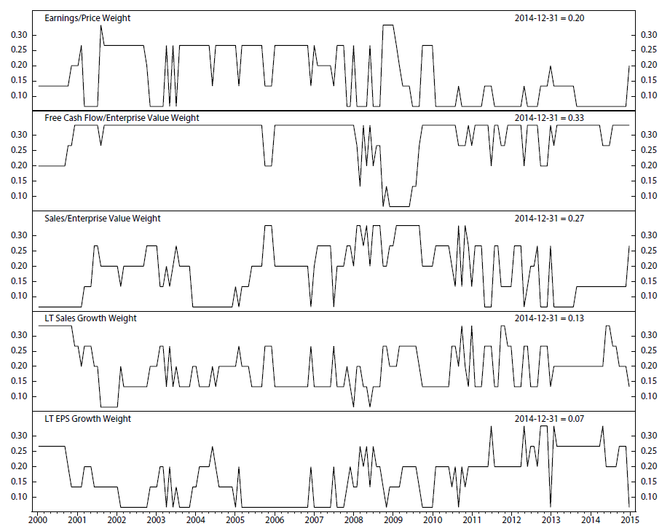
Alternative Ideas
If using Machine Learning
1. Directional Change from Price Prediction to Portfolio Selection
Using HMMs to predict a vector with binary elements (1 and 2) representing the macroeconomics factors (e.g. inflation, industrial index etc.).
Finding the closet window that has the similar economics pattern.
Evaluating stocks based on financial ratios and their corresponding dynamic weights
Updating the portfolio accordingly.
Introduction | Basic Strategy | Improvised Strategy | Discussion | Conclusion

Slide 21
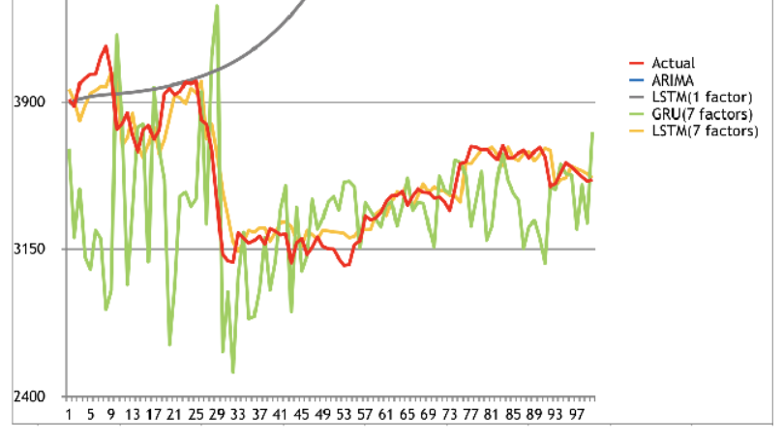
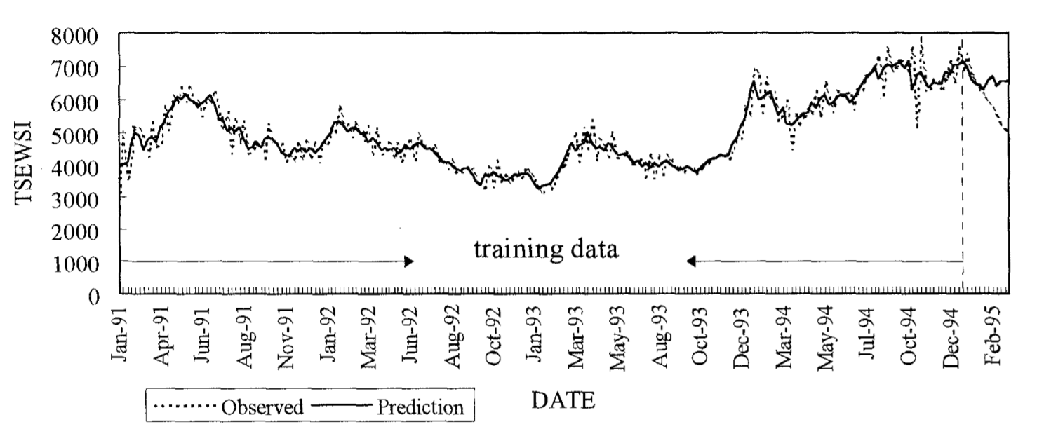
Alternative Ideas
If using Machine Learning
2. Use Other Machine Learning Models
Recursive neutral networks and other hybrid models incorporate history for prediction (?)
Introduction | Basic Strategy | Improvised Strategy | Discussion | Conclusion
Notes:
[1] A Multi-factor Approach for Stock Price Prediction by using Recurrent Neural Networks
[2] https://ieeexplore-ieee-org.ezp.lib.unimelb.edu.au/stamp/stamp.jsp?tp=&arnumber=549236 Stock Market Trend Prediction Using ARIMA-based Neural Network

Slide 22
Conclusion

